Slide 1
AYAN DEEP HAZRA NLP GROUP 04/27/2021

Slide 2
Summary of Work
Date | Hours Worked | Description
04/27/2021 | 5 | Tried to run CDE parser on the 1 sentence (3)
04/26/2021 | 3 | Tried to make changes to the Parser files and build one

Slide 3
Summary
Verified 10 papers and sentences.
Tried to run CDE on these 10 papers.
Cde was not able to detect any sentences.
Tried to build parser.

Slide 4
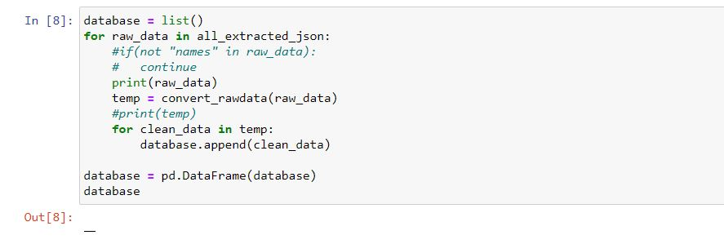
Results
No database being displayed.
Lots of processing time for nxml in CDE.

Slide 5
Problems
Unsure about the processing time per paper.
Slowed my research process down.

Slide 6
Next Steps
Need to understand how Base Parser works.
Have to use BaseParser to finish the parser.

